Slide 1
C++ Standard Template Library (STL) Md. Alamgir Hossain Senior Lecturer, Dept. of CSE, Prime University Mail: alamgir.cse14.just@gmail.com

Slide 2
C++ STL
The Standard Template Library (STL) is a set of C++ template classes to provide common programming data structures and functions such as lists, stacks, arrays, etc.
It is a library of container classes, algorithms, and iterators.
It is a generalized library and so, its components are parameterized.
STL has four components: Algorithms, Containers, Functions, Iterators

Slide 3
Algorithms
The header algorithm defines a collection of functions specially designed to be used on ranges of elements.
They act on containers and provide means for various operations for the contents of the containers.
Algorithms Likes: Sorting, Searching, Important STL Algorithms etc.

Slide 4
Containers
Containers or container classes store objects and data.
Examples of containers are: vector, list, deque, arrays, queue, stack, set, multiset, map, multimap, etc.

Slide 5
Functions and Iterators
Function: The STL includes classes that overload the function call operator. Instances of such classes are called function objects or functors.
Functors allow the working of the associated function to be customized with the help of parameters to be passed.
Iterators: As the name suggests, iterators are used for working upon a sequence of values.

Slide 6
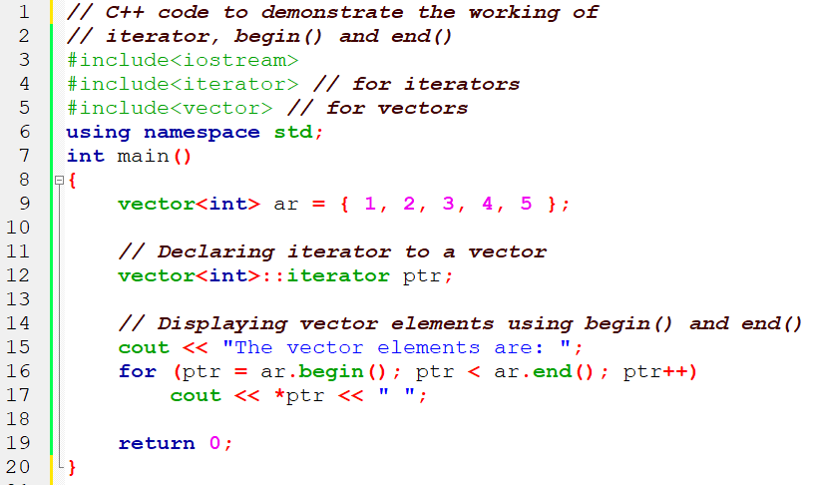
Example of Iterator

Slide 7
Thank You

